Slide 1

Welcome to:
Thursday, November 11th, 2016
Broun Hall Room 235

Slide 2
Introduction
Founded in 2006 by the Auburn University ECE Department
Acts as a “makerspace” that provides a place for students to work collaboratively on projects.
Provides the space, tools, and some resources for these projects.
No prior experience is required.
Great for students of all ages and majors.
Can act as a pathway to get involved in Undergraduate Research.

Slide 3
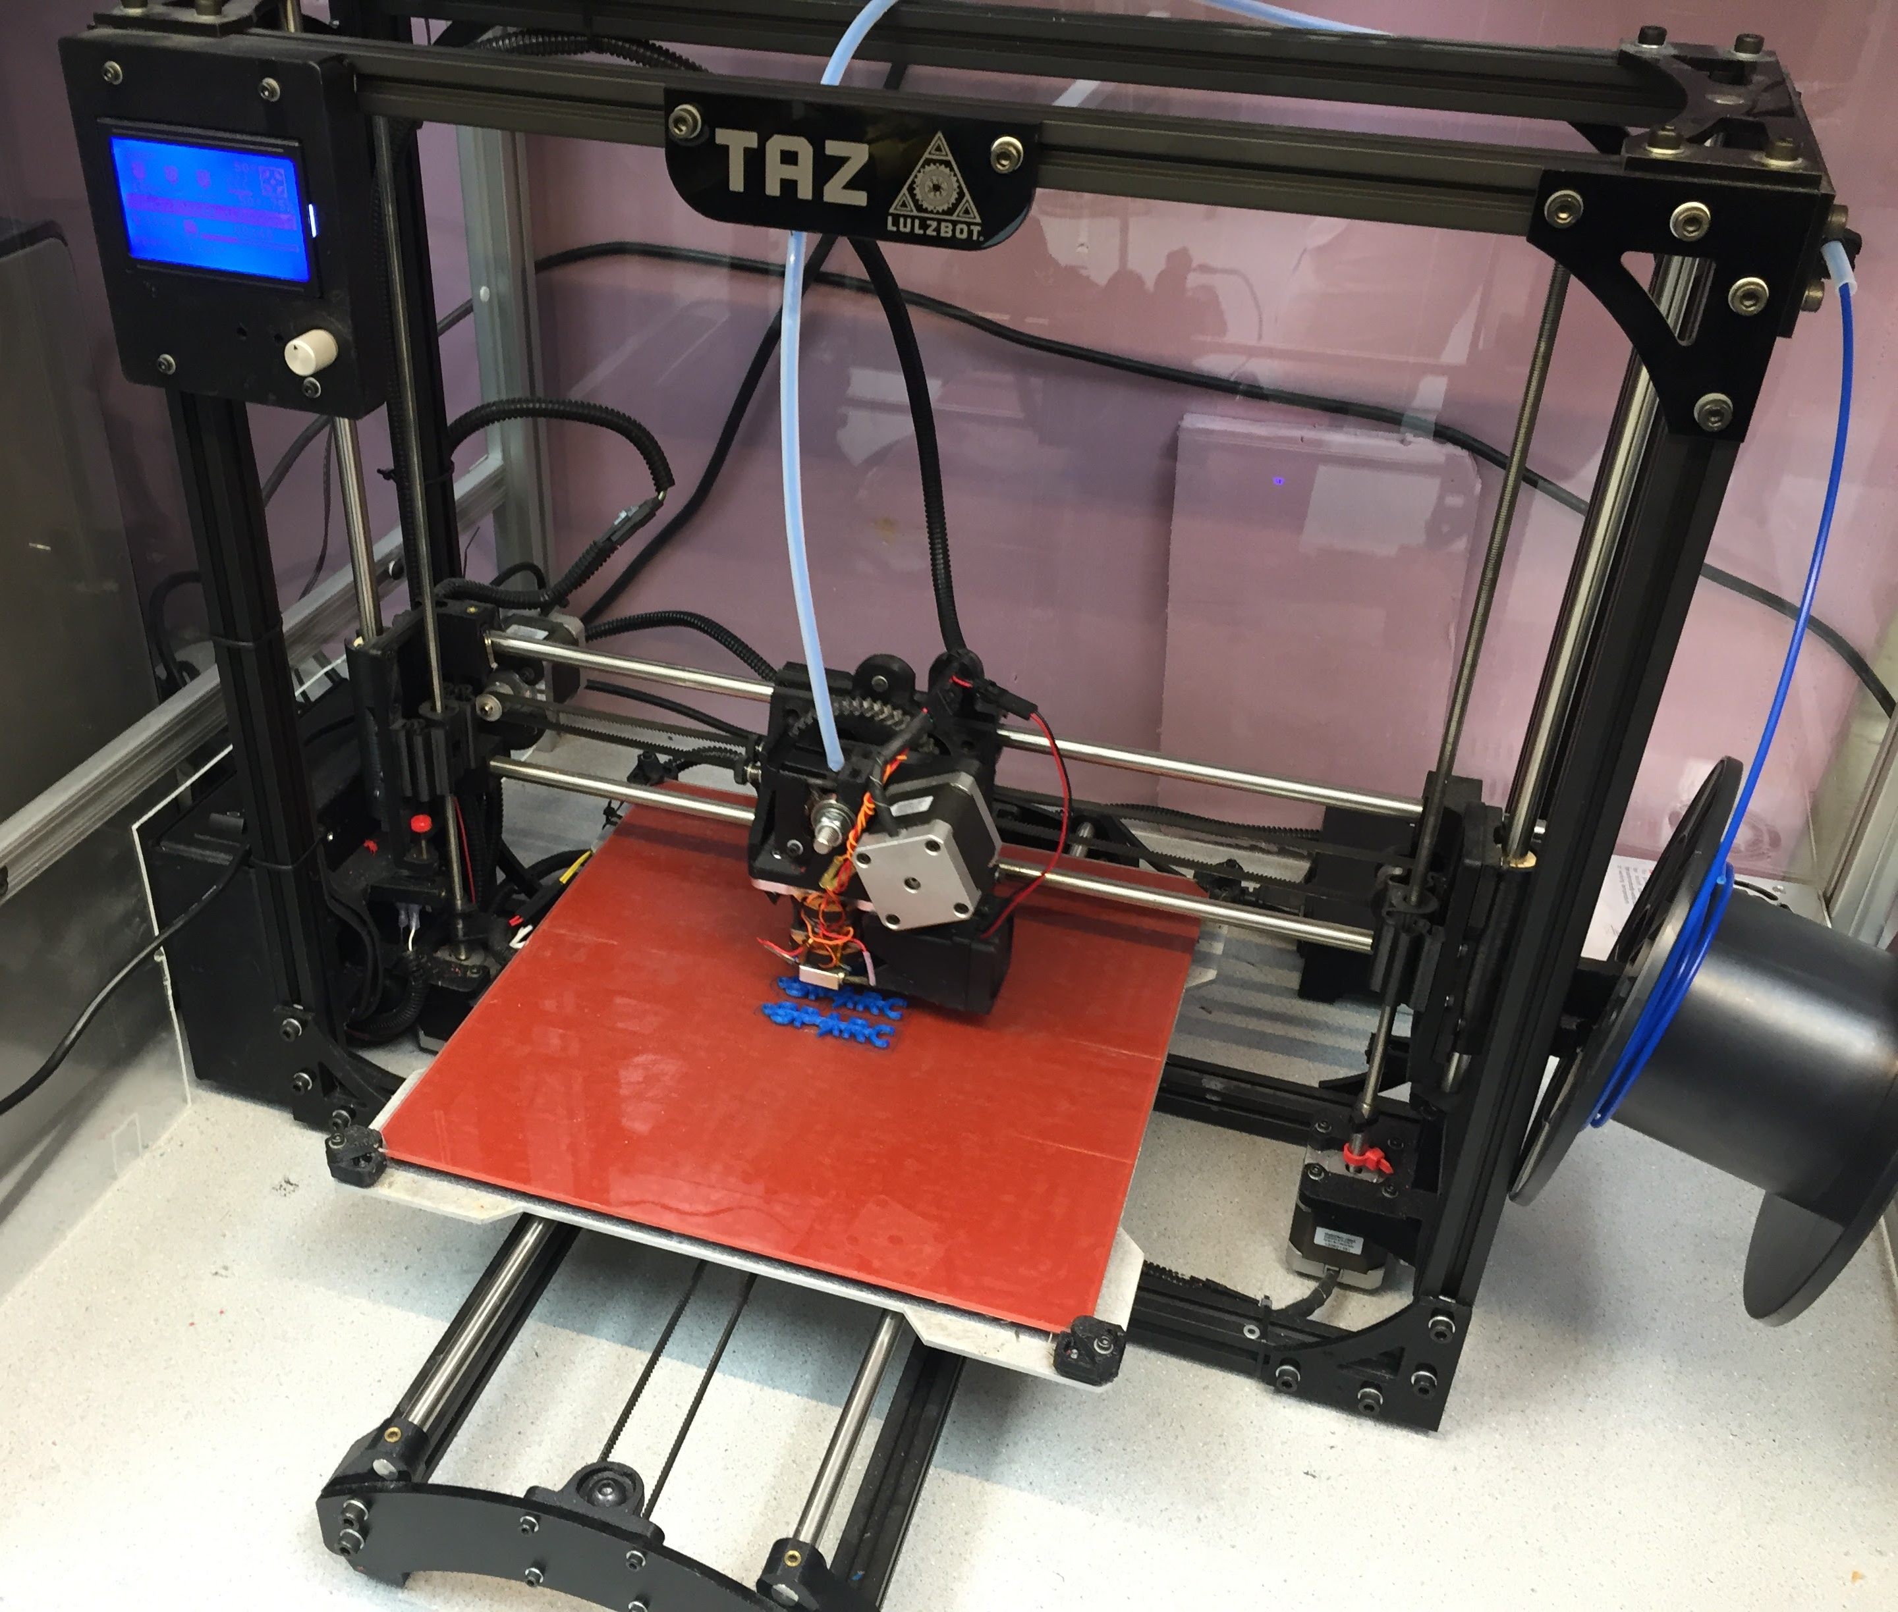
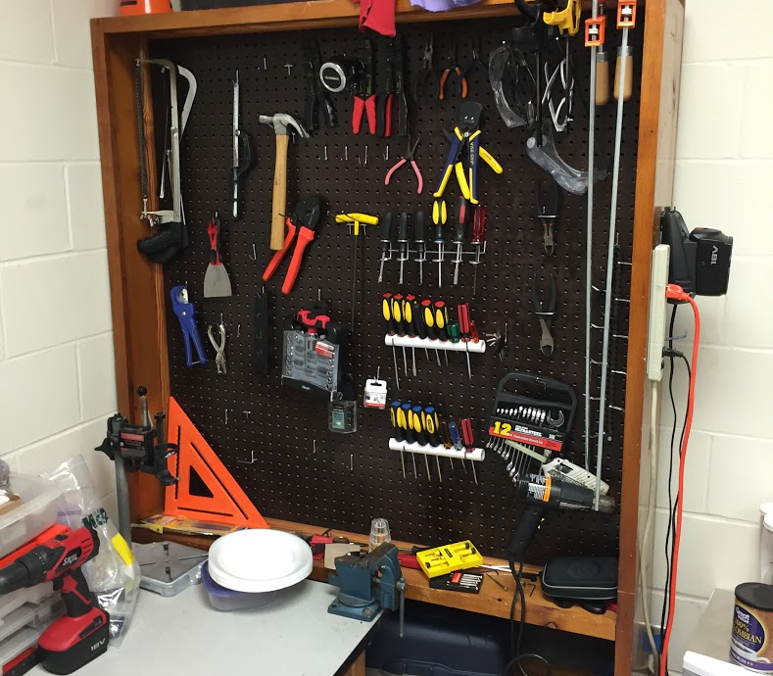
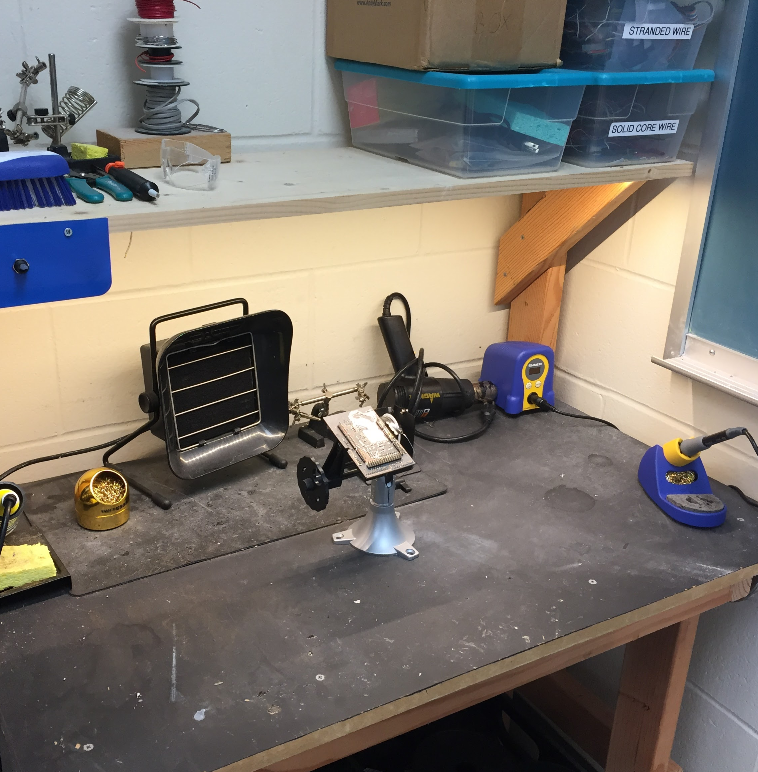
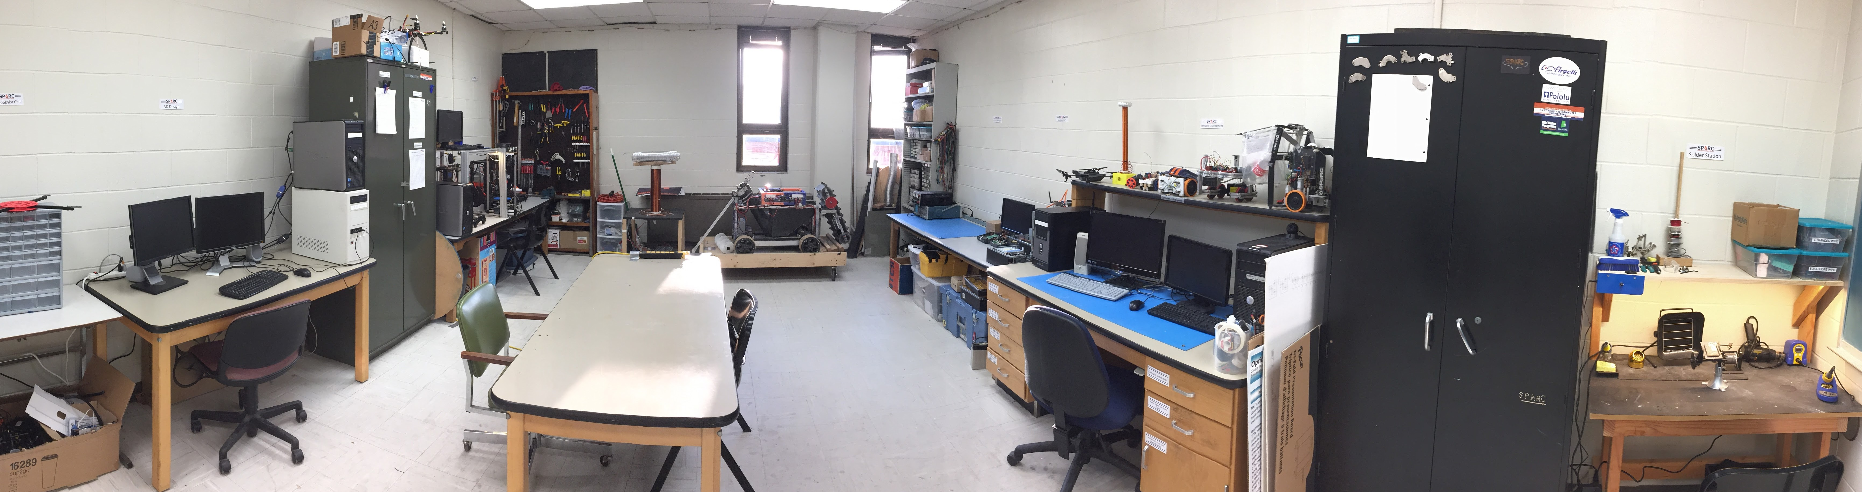
Our Lab
Broun Hall
Room: 367

Slide 4
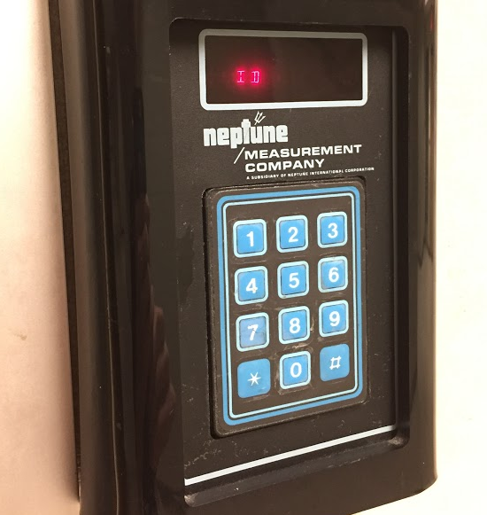
How to become a Member
Log 5 constructive hours in the lab
Write the times on the sheet on the cabinet on the left side of the room.
Contact our Secretary:
William Crubaugh
Email: wcc0023@auburn.edu
Include your Banner ID #
Then visit Autry May to get Code Access
Office: Broun Hall Room 252
Email: eceshop@auburn.edu
You will be given code access code that will give you 24/7 access to Broun 367 and Broun Hall.

Slide 5
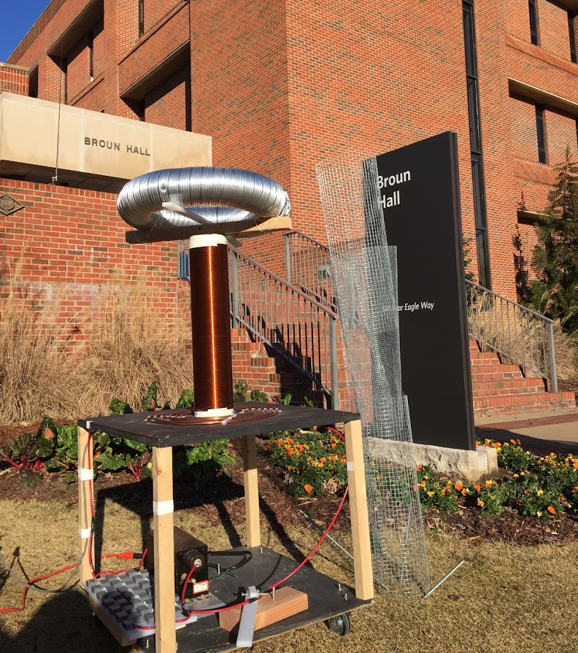
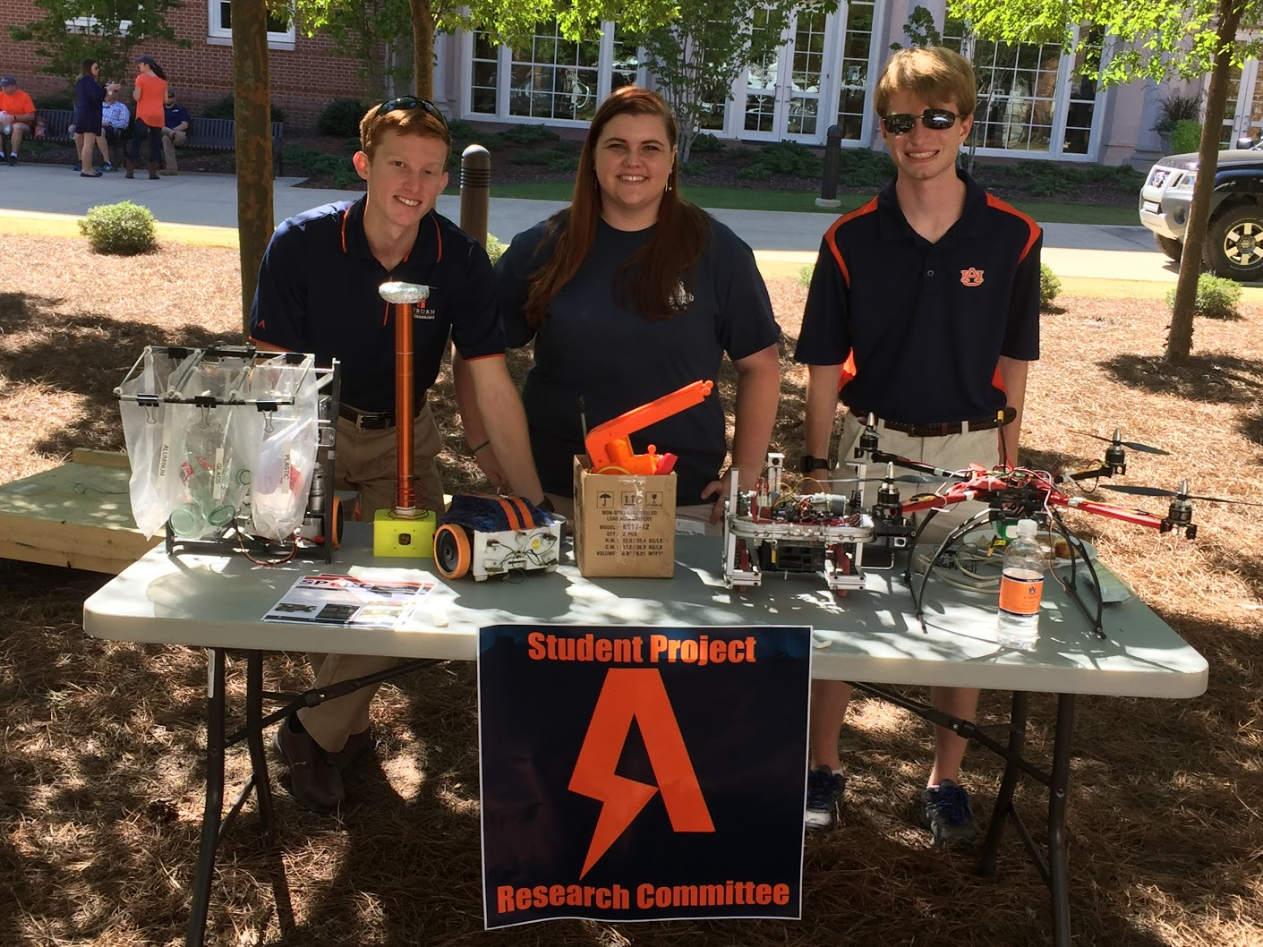
Outreach Events
Outreach Coordinator- Jack Thomas jet0024@auburn.edu
Fall 2016
Loachapoka Robotics Mentoring- Mondays, Tuesdays, and Thursdays 3:00PM to 4:30PM
ECE Minority Presentation- November 14th
AJHS E-Day- November 17th
South’s Best- December 3-4th
SCORE Claw Machine- December 3-4th
Spring 2016
E-Day- Late February or early March
SPACE Day- Possible Event Next Semester
IEEE Sumo Robotics Competition (with local middle and high schools)- Spring 2017
E-Day 2016 Tesla Coil Demonstration
Engineering Tailgate SPARC Table

Slide 6

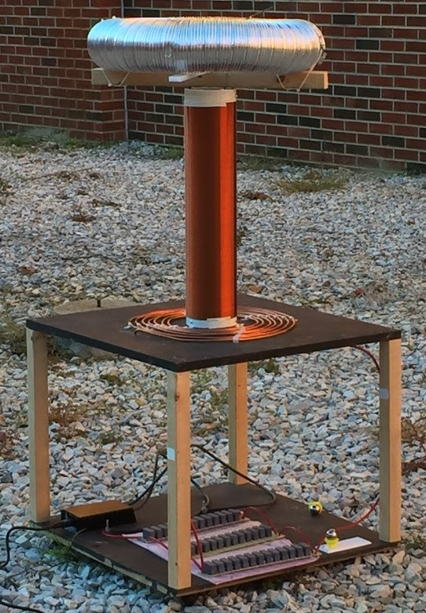
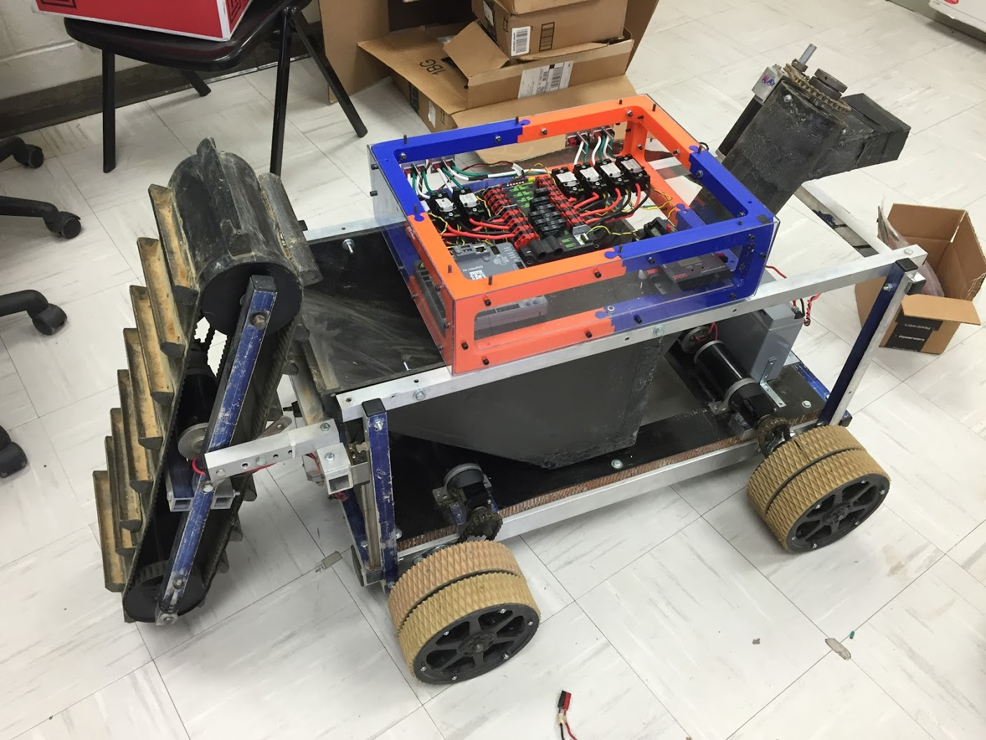
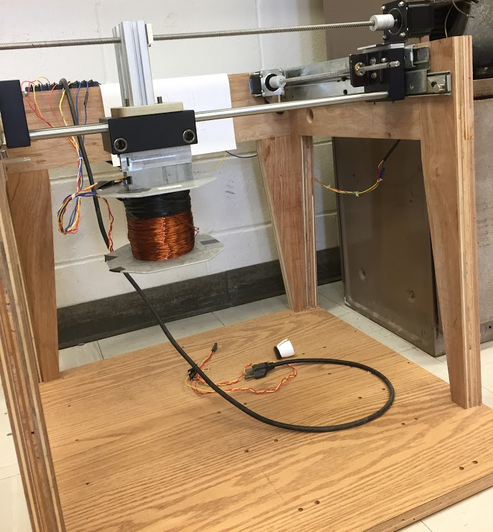
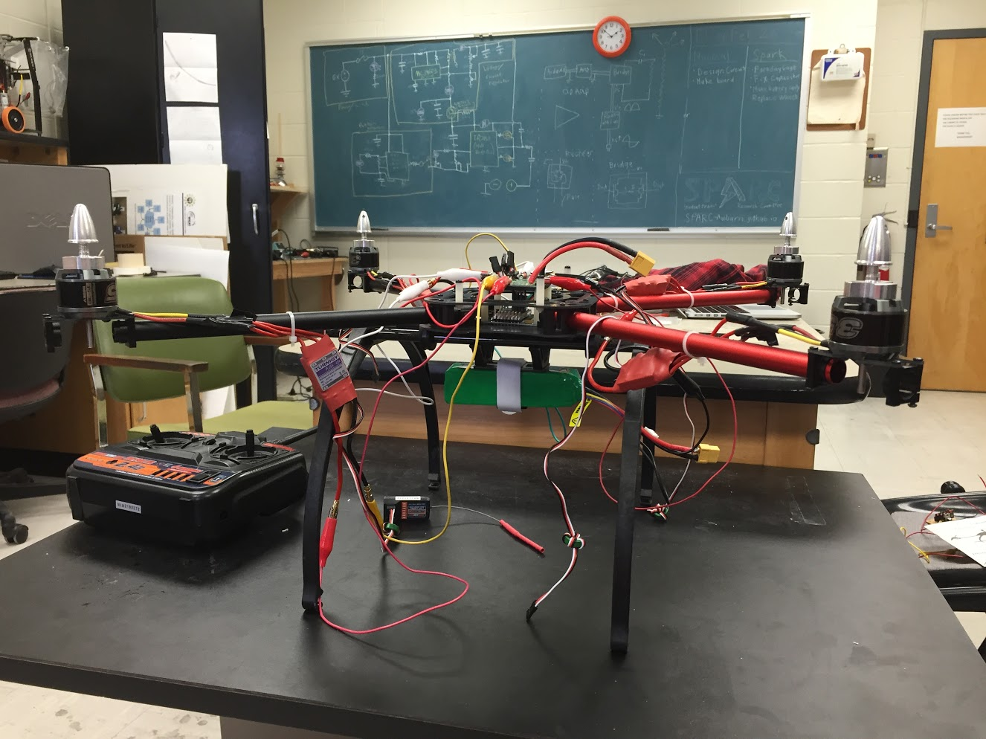
Current Projects and Teams
Robotics and Automation
NASA RMC
Automated Lab
Research
Smart Helmet
MAGLEV
Cryo-Electronics
Unmanned Aerial Vehicles
RC Hobbyist Club
Josh’s Quadcopter
Outreach and Demonstration
Claw Machine
Tesla Coil
Denotes that this project has an active GroupMe

Slide 7
Projects: NASA Robotics Mining Competition
A 3rd Year Robotics team that designs and builds a robot
collects simulated Martian soil in a small arena
dispenses it into a small bin on the other side of the arena.
Can be remotely controlled or for bonus points autonomously controlled
Competition is held at the Kennedy Space Center this year from May 22nd-26th, 2017
Part of Auburn’s SPACE Club and affiliated with SPARC.
Team Lead:
Jeremy Frasher jjf0010@auburn.edu
Meetings:
Mondays 6:15 PM
2016 NASA RMC Robot

Slide 8
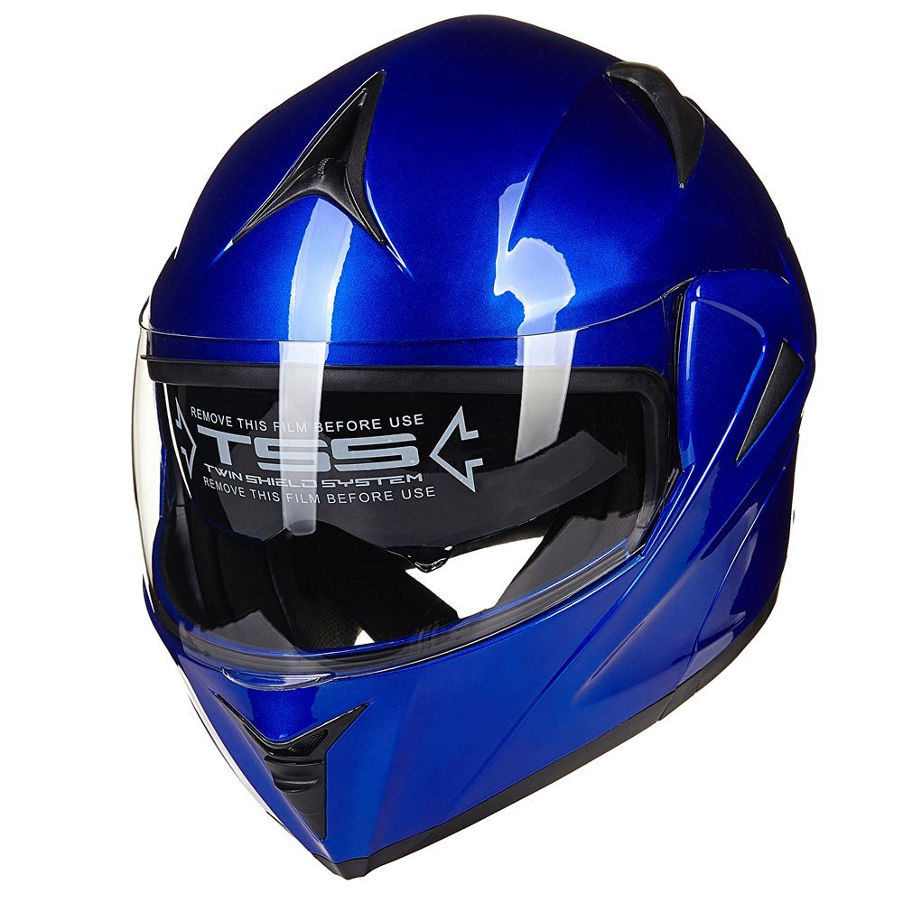
Projects: Motorcycle Smart Helmet
Create a helmet that acts as an “OnStar” system for motorcyclists.
Will have accelerometer, gyroscope, and camera functionality to detect crashes.
Will allow 911 calling in helmet.
Uses a “hacked” Android phone as hardware.
Android Studio is being used to develop app.
Team Lead:
Noah Niedzwiecki nmn0005@auburn.edu
Meetings:
Wednesday 5pm-6pm
Possible Helmet

Slide 9
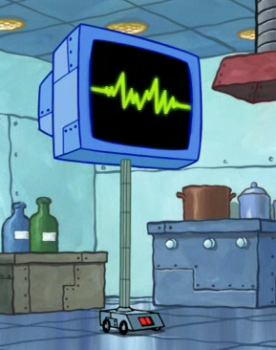

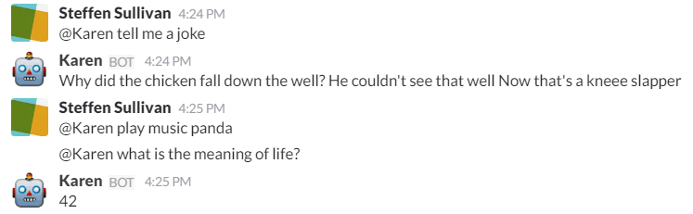
Projects: Automated Lab
Create an automated lab assistant.
Will be voiced controlled.
Will allow door to be unlocked temporarily remotely to allow new members access to the lab.
Will consist of both a stationary and mobile system.
Will be embedded on the new group chat system Slack.
Team Lead:
Josh Jablonowski jdj0019@auburn.edu
Meetings:
Wednesdays 6:00pm-7:00pm
Location- SPARC Lab Broun 367
Kinematic
Autonomous
Robot
Enriches
Newcomers

Slide 10
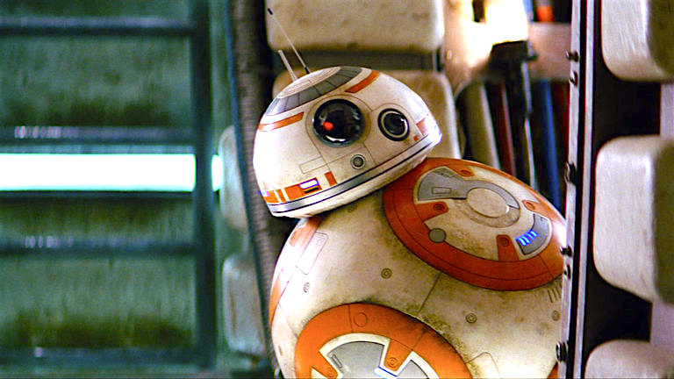
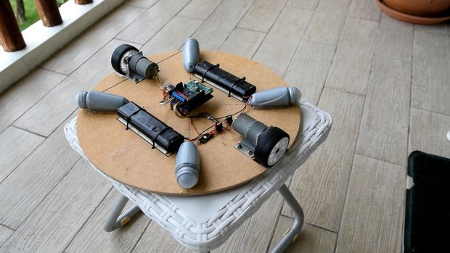
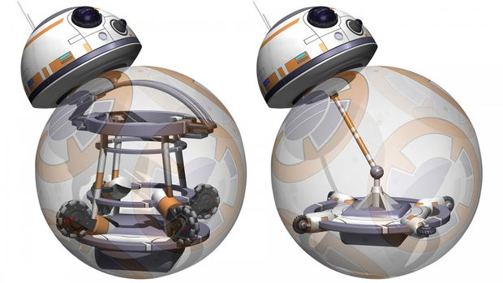
Projects: BB-8 robot
Build a robot that uses an internal mechanism to manipulate a ball to move around.
Also has semispherical “head” with sensors to detect surroundings.
A great E-Day project.
Will possibly be used as a tourbot with a built in projector in the head.
Based off of Instructables tutorials: http://www.instructables.com/id/DIY-Life-Size-Phone-Controlled-BB8-Droid/
Team Lead:
Jonathon Brown
Meetings:
Wednesdays 6:00pm-7:00pm
Location- SPARC Lab Broun 367

Slide 11
Projects: MAGLEV
Originally a senior design project involving magnetic levitation of small metal objects.
Uses 2 dimensional axes to move an electromagnet.
By varying frequency in coil, it can “sing” War Eagle
Also will be used for SCORE Crane Machine
Team Lead:
Shane Williams smw0031@auburn.edu
Meetings:
Not set

Slide 12
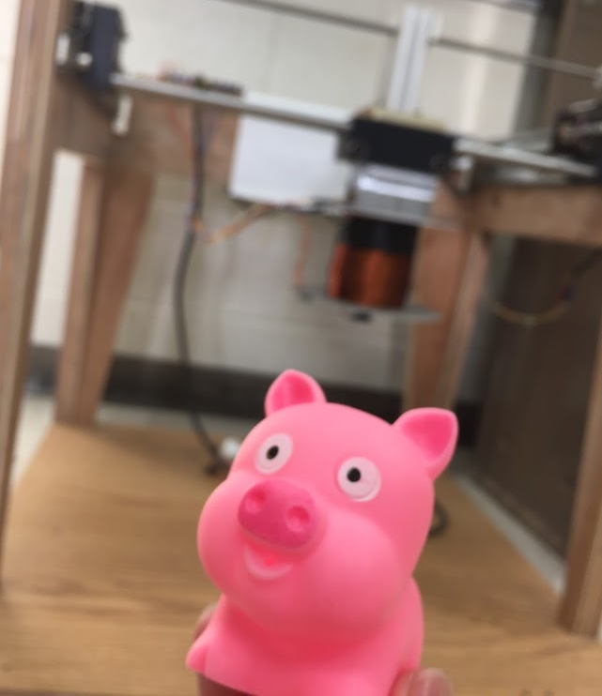
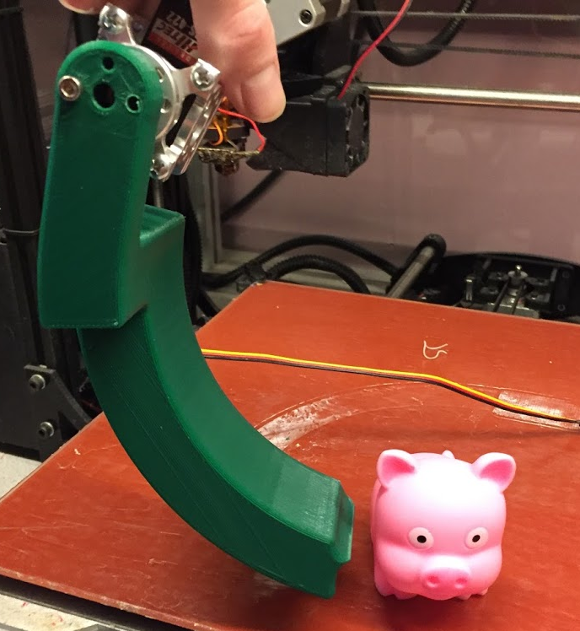
Projects: SCORE Crane Machine
Build a claw machine where “everyone wins”.
Will provide a fun way to distribute promotional items for the Southeastern Center of Robotics Education (SCORE).
Suspend a 3D printed servo controlled claw vertically from the MAGLEV dual axis actuation system.
People will use a joystick to manipulate it and pick objects.
Team Lead:
Matthew Castleberry mtc0030@auburn.edu
Meetings:
Tuesdays 5:00pm-6:00pm
Location- SPARC Lab Broun 367

Slide 13
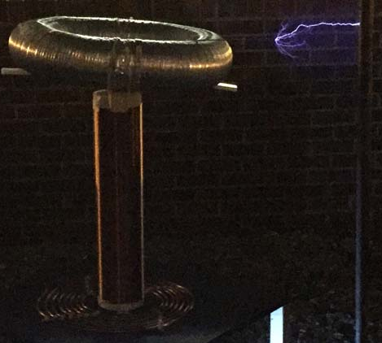
Projects: Tesla Coil
Last year we created a spark gap Tesla Coil.
It generated 400,000 volts of electricity
We have purchased a new transformer to permanently install on it.
Goals this year:
Make it operational again
Enhance it using homemade capacitors
Make it musical

Slide 14
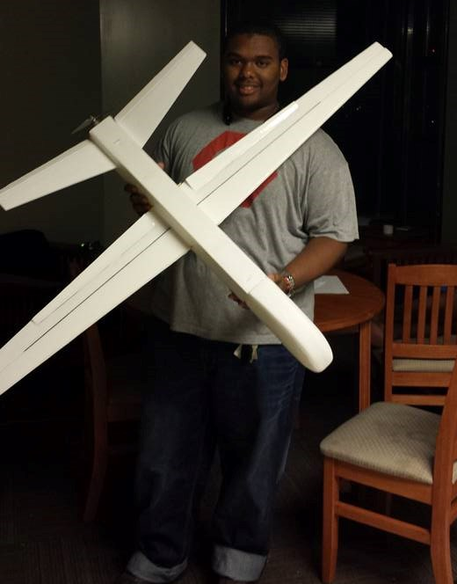
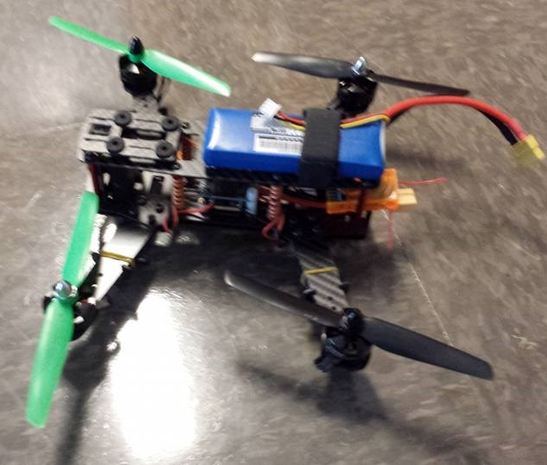
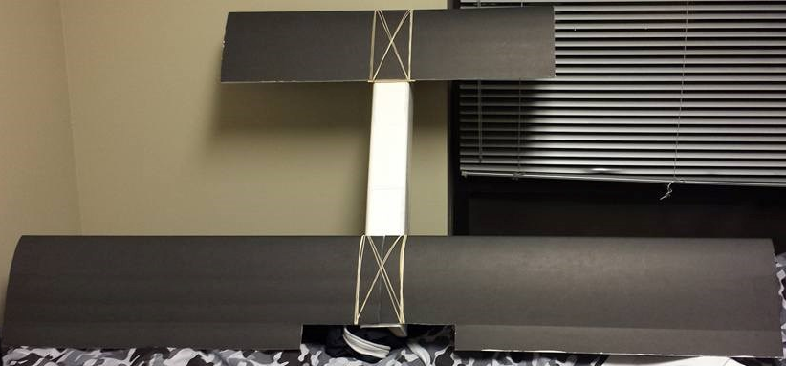
Projects: RC Hobbyist Club (RCHC)
Teaches 3D design, construction and control of RC airplanes, multi-copters, cars, and boats.
Designed to need no prior experience.
Functions very similar to SPARC
Meetings:
Mondays 5:00pm-6:00pm in Shelby
Fridays 3:00pm-4:00pm in Broun 235
Dues
$10 per semester
Club President
Joshua Parker jcp0048@auburn.edu

Slide 15
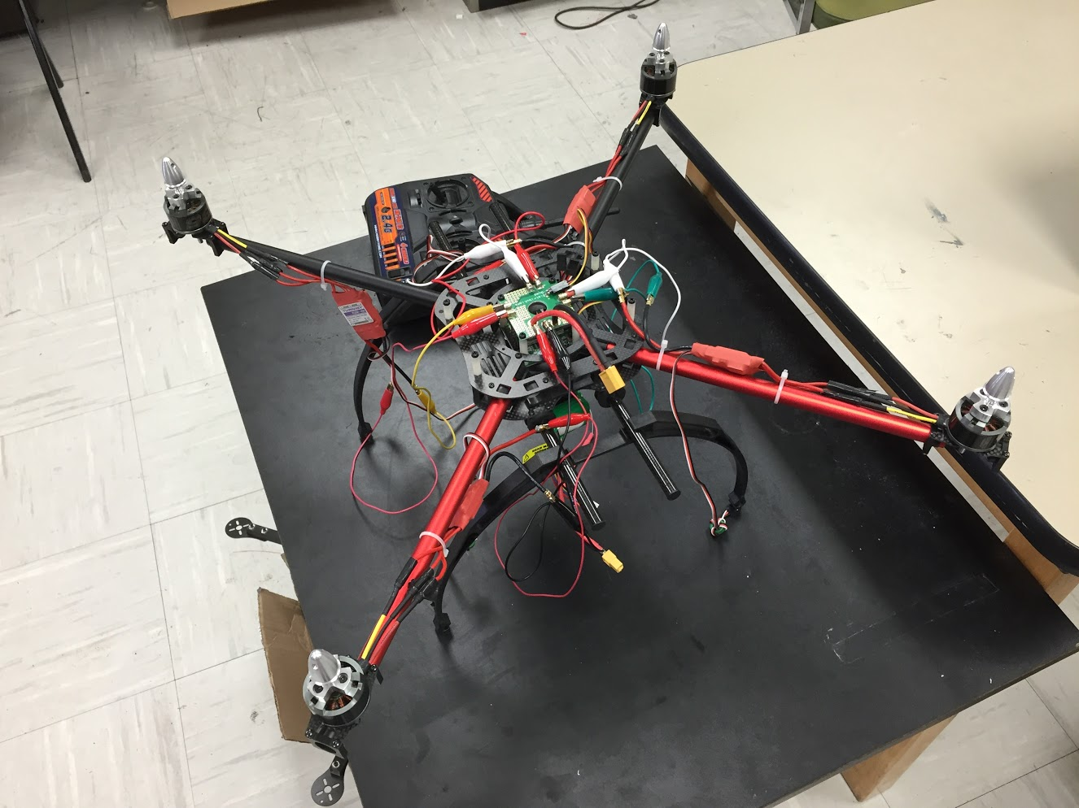
Projects: Quadcopter
A personal project by Josh.
3 years in the making
Joint project between SPARC and RC Hobbyist Club
Goals:
Solve an issue with one of the speed controllers and motors to enable the quadcopter to fly.
Possibly put an Arduino or Raspberry Pi on board for autonomous or semi-autonomous flight.
Team Lead:
Josh Jablonowski jdj0019@auburn.edu
Meetings:
Not set

Slide 16
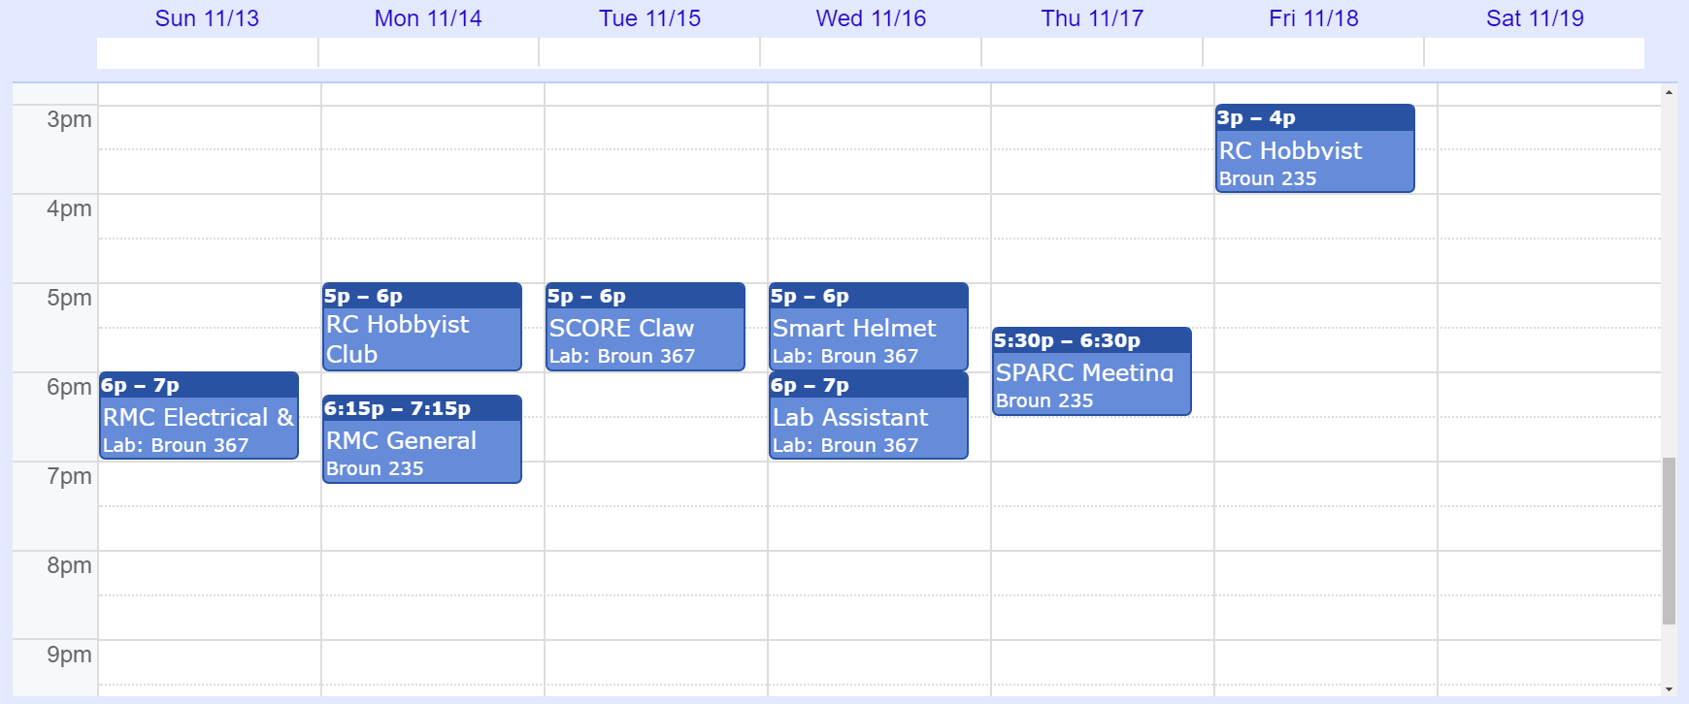
Meetings Schedule: Week of 11/13

Slide 17
SPARC T-SHIRTs
The SPARC T-Shirt is a Blue Jean colored short sleeve Comfort Color T-Shirt.
Please pay cash to one of the Officers or use the Pay Pal on the SPARC website:
http://sparc-auburn.github.io/#resourcessection
X-Large- $11
2X-Large- $12
3X-Large- $13
Small- $11
Medium- $11
Large- $11

Slide 18
Useful Links
Website
http://sparc-auburn.github.io/
Github
https://github.com/SPARC-Auburn
SPARC Documents
https://github.com/SPARC-Auburn/Documents
AU Involve Page
https://auburn.collegiatelink.net/organization/SPARC

Slide 19
Maker Training Sessions
Thursday, November 3rd- Robotics/Control Systems
Thursday, November 10th- Pizza Party
Thursday, November 17th- TBD
Thursday, December 1st- No Meeting in preparation for finals

